Slide 1
CSCI 475/585 Information Security and Privacy Fall 2019
Chapter 1 – Overview
Week 1
1.2 Security Terminology and Architecture
Notes:
Lecture slides prepared by Dr Lawrie Brown (UNSW@ADFA) for “Computer Security: Principles and Practice”, by William Stallings and Lawrie Brown, Chapter 1 “Overview”.
Enhanced and Modified by Chuan Yue at the Colorado School of Mines.

Slide 2
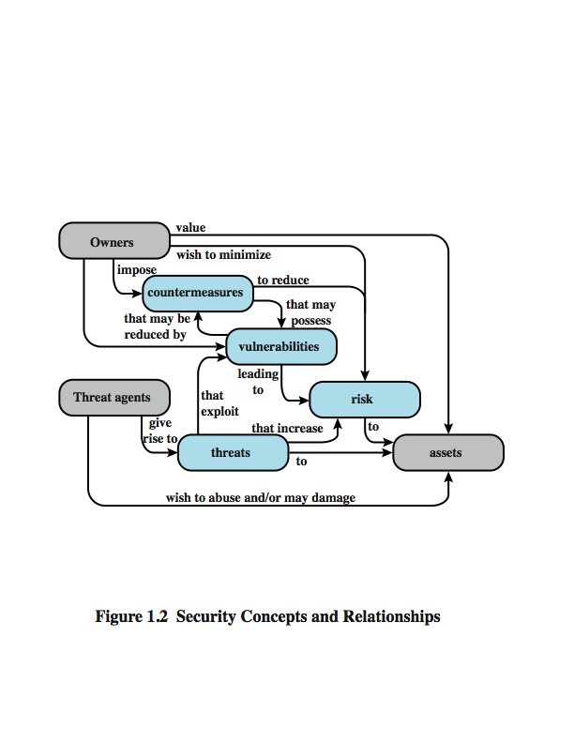
Security Terminology
“Where a threat intersects with a vulnerability, risk is present” – NIST Special Publication 800-100: Information Security Handbook: A Guide for Managers
Notes:
Enhanced and Modified by Chuan Yue at the Colorado School of Mines.
Figure 1.2 [CCPS04a] shows the relationship among some terminology that will be useful throughout the book, drawn from RFC 2828, Internet Security Glossary:
Adversary (threat agent) - An entity that attacks, or is a threat to, a system.
Attack -An assault on system security that derives from an intelligent threat; a deliberate attempt to evade security services and violate security policy of a system.
Countermeasure - An action, device, procedure, or technique that reduces a threat, a vulnerability, or an attack by eliminating or preventing it, by minimizing the harm it can cause, or by discovering andreporting it so that corrective action can be taken.
Risk - An expectation of loss expressed as the probability that a particular threat will exploit a particular vulnerability with a particular harmful result.
Security Policy - A set of rules and practices that specify how a system or org provides security services to protect sensitive and critical system resources.
System Resource (Asset) - Data; a service provided by a system; a system capability; an item of system equipment; a facility that houses system operations and equipment.
Threat - A potential for violation of security, which exists when there is a circumstance, capability, action, or event that could breach security and cause harm.
Vulnerability - Flaw or weakness in a system's design, implementation, or operation and management that could be exploited to violate the system's security policy.

Slide 3
Vulnerabilities and Attacks
system resource vulnerabilities may
be corrupted (loss of integrity)
become leaky (loss of confidentiality)
become unavailable (loss of availability)
attacks are threats carried out and may be
passive
active
insider
outsider
Notes:
In the context of security, our concern is with the vulnerabilities of system resources which [NRC02] shows may be:
• corrupted, so that it does the wrong thing or gives wrong answers. e.g. data stored may be different from what it should be because it has been improperly modified.
• become leaky. e.g. someone who should not have access to some or all of the information available through the network obtains such access.
• become unavailable or very slow. e.g. using the system / network impossible.
These three general types of vulnerability correspond to the concepts of integrity, confidentiality, and availability, enumerated earlier in this section.
Corresponding to the various types of vulnerabilities to a system resource are threats that are capable of exploiting those vulnerabilities, which represent a potential security harm to an asset. An attack is a threat that is carried out. We can distinguish two type of attacks:
• Active attack: attempts to alter system resources or affect their operation
• Passive attack: attempts to learn or make use of information from the system but does not affect system resources
We can also classify attacks based on the origin of the attack:
• Inside attack: Initiated by an entity inside the security perimeter (an "insider)
• Outside attack: Initiated from outside the perimeter, by an unauthorized or illegitimate user of the system (an "outsider").

Slide 4
Security & Privacy Vulnerabilities - The Path to Exploitation
Vulnerabilities are pervasive in computer & network systems:
Req. analysis, design, implementation, deployment, maintenance, ...
Web-based, cloud-based, mobile-based, ...
Application, middleware, OS, VMM, Hardware, ...
Functionality related, usability related, ...
Human users
Notes:
Added by Chuan Yue at the Colorado School of Mines.

Slide 5
Countermeasures
means used to deal with security attacks
prevent
detect
recover
may result in new vulnerabilities
will have residual vulnerability
goal is to minimize risk given constraints
Notes:
A countermeasure is any means taken to deal with a security attack. Ideally, a countermeasure can be devised to prevent a particular type of attack from succeeding. When prevention is not possible, or fails in some instance, the goal is to detect the attack, and then recover from the effects of the attack. A countermeasure may itself introduce new vulnerabilities. In and case, residual vulnerabilities may remain after the imposition of countermeasures. Such vulnerabilities may be exploited by threat agents representing a residual level of risk to the assets. Owners will seek to minimize that risk given other constraints.

Slide 6
Security Functional Requirements
technical measures:
access control; identification & authentication; system & communication protection; system & information integrity
management controls and procedures
awareness & training; audit & accountability; certification, accreditation, & security assessments; contingency planning; maintenance; physical & environmental protection; planning; personnel security; risk assessment; systems & services acquisition
overlapping technical and management:
configuration management; incident response; media protection
Notes:
Here we view countermeasures in terms of functional requirements, and we follow the classification defined in FIPS PUB 200 (Minimum Security Requirements for Federal Information and Information Systems). This standard enumerates seventeen security-related areas, and are defined in Table 1.4 in the text. The requirements listed in FIP PUB 200 encompass a wide range of countermeasures to security vulnerabilities and threats. Each of the functional areas may involve both computer security technical measures and management measures. Functional areas that are primarily require computer security technical measures include access control; identification and authentication; system and communication protection; and system and information integrity. Functional areas that primarily involve management controls and procedures include awareness and training; audit and accountability; certification, accreditation, and security assessments; contingency planning; maintenance; physical and environmental protection; planning; personnel security; risk assessment; and systems and services acquisition. Functional areas that overlap computer security technical measures and management controls include configuration management; incident response; and media protection.

Slide 7
X.800 Security Architecture
X.800, Security Architecture for OSI
systematic way of defining requirements for security and characterizing approaches to satisfying them
defines:
security attacks
security mechanisms
security services
Notes:
ITU-T Recommendation X.800, Security Architecture for OSI, defines a systematic way of defining the requirements for security and characterizing the approaches to satisfying those requirements. The OSI security architecture is useful to managers as a way of organizing the task of providing security. The OSI security architecture focuses on security attacks, mechanisms, and services. These can be defined briefly as:
• Security attack: Any action that compromises the security of information owned by an organization. cf. network security attacks slide earlier
• Security mechanism: A mechanism that is designed to detect, prevent, or recover from a security attack. cf. functional requirements from previous slide or Table 1.6 in text.
• Security service: A service that enhances the security of the data processing systems and the information transfers of an organization. The services are intended to counter security attacks, and they make use of one or more security mechanisms to provide the service. cf CIA security concepts earlier, or Table 1.5 in text.

Slide 8
Security Attack
Passive Attacks
A passive attack attempts to learn or make use of information from the system but does not affect system resources.
Active Attacks
An active attack attempts to alter system resources or affect their operation.
Notes:
A useful means of classifying security attacks, used both in X.800 and RFC 2828, is in terms of passive attacks and active attacks. A passive attack attempts to learn or make use of information from the system but does not affect system resources.
Passive attacks are in the nature of eavesdropping on, or monitoring of, transmissions. The goal of the opponent is to obtain information that is being transmitted. Two types of passive attacks are:
+ release of message contents - as shown above in Stallings Figure 1.2a here
+ traffic analysis - monitor traffic flow to determine location and identity of communicating hosts and could observe the frequency and length of messages being exchanged
These attacks are difficult to detect because they do not involve any alteration of the data.

Slide 9
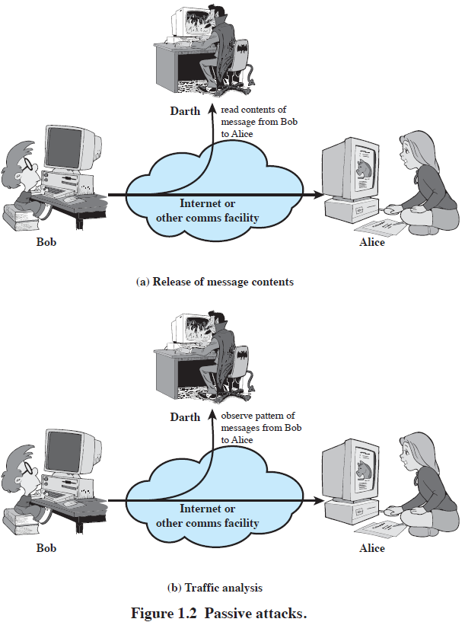
Passive Attacks
Passive attacks are difficult to detect because they do not involve any alteration of the data.
Our main goal is to prevent their success.
Notes:
Enhanced and Modified by Chuan Yue at the Colorado School of Mines.
A useful means of classifying security attacks, used both in X.800 and RFC 2828, is in terms of passive attacks and active attacks. A passive attack attempts to learn or make use of information from the system but does not affect system resources.
Passive attacks are in the nature of eavesdropping on, or monitoring of, transmissions. The goal of the opponent is to obtain information that is being transmitted. Two types of passive attacks are:
+ release of message contents - as shown above in Stallings Figure 1.2a here
+ traffic analysis - monitor traffic flow to determine location and identity of communicating hosts and could observe the frequency and length of messages being exchanged
These attacks are difficult to detect because they do not involve any alteration of the data.

Slide 10
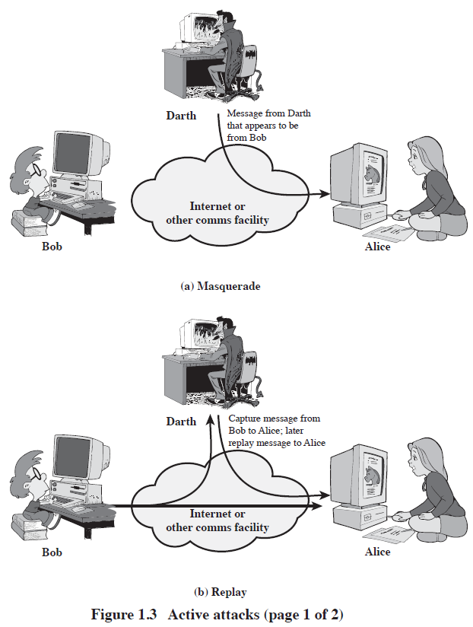
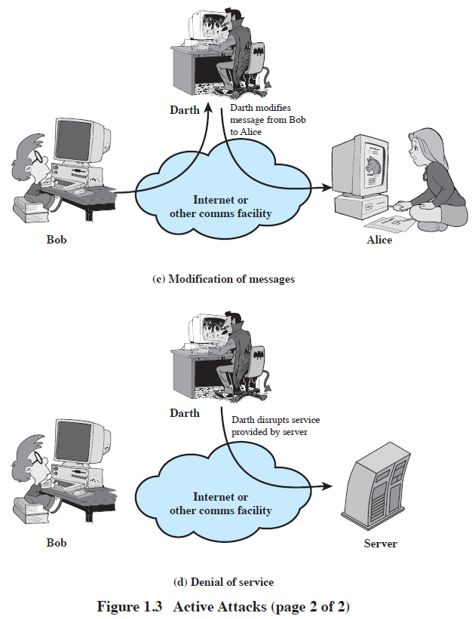
Active Attacks
Active attacks are difficult to prevent because of the wide variety of potential physical, software, and network vulnerabilities.
Our main goal is to detect them and to recover from any disruption or delays caused by them.
Notes:
Enhanced and Modified by Chuan Yue at the Colorado School of Mines.
Active attacks involve some modification of the data stream or the creation of a false stream and can be subdivided into four categories: masquerade, replay, modification of messages, and denial of service:
masquerade of one entity as some other
replay previous messages (as shown above in Stallings Figure 1.3b)
modify/alter (part of) messages in transit to produce an unauthorized effect
denial of service - prevents or inhibits the normal use or management of communications facilities
Active attacks present the opposite characteristics of passive attacks. Whereas passive attacks are difficult to detect, measures are available to prevent their success. On the other hand, it is quite difficult to prevent active attacks absolutely, because of the wide variety of potential physical, software, and network vulnerabilities. Instead, the goal is to detect active attacks and to recover from any disruption or delays caused by them.

Slide 11
Security Services
X.800: “a service provided by a protocol layer of communicating open systems, which ensures adequate security of the systems or of data transfers”
RFC 2828: “a processing or communication service provided by a system to give a specific kind of protection to system resources”
uses one or more security mechanisms
often replicates functions normally associated with physical documents
for example, have signatures, dates; need protection from disclosure, tampering, or destruction; be notarized or witnessed; be recorded or licensed
Notes:
Enhanced and Modified by Chuan Yue at the Colorado School of Mines.
State here a couple of definitions of “security services” from relevant standards. X.800 defines a security service as a service provided by a protocol layer of communicating open systems, which ensures adequate security of the systems or of data transfers. Perhaps a clearer definition is found in RFC 2828, which provides the following definition: a processing or communication service that is provided by a system to give a specific kind of protection to system resources; security services implement security policies and are implemented by security mechanisms.

Slide 12
Security Services (X.800)
Authentication - assurance that communicating entity is the one claimed
have both peer-entity & data origin authentication
Access Control - prevention of the unauthorized use of a resource
Data Confidentiality –protection of data from unauthorized disclosure
Data Integrity - assurance that data received is as sent by an authorized entity, no modification, replay, etc.
Non-Repudiation - protection against denial by one of the parties in a communication
Availability – resource accessible/usable
Notes:
This list is taken from Stallings Table 1.2 which provides details of the 5 Security Service categories and the 14 specific services given in X.800.
This list includes the various "classic" security services which are traditionally discussed. Note there is a degree of ambiguity as to the meaning of these terms, and overlap in their use. The broad service categories are:
authentication is concerned with assuring that a communication is authentic. Two specific authentication services are defined in X.800: Peer entity authentication: provides corroboration of the identity of a peer entity in an association; and Data origin authentication: provides corroboration of the source of a data unit.
access control is the ability to limit and control the access to host systems and applications via communications links.
confidentiality is the protection of transmitted data from passive attacks, and the protection of traffic flow from analysis.
integrity assures that messages are received as sent, with no duplication, insertion, modification, reordering, replay, or loss.
availability is the property of a system / resource being accessible and usable upon demand by an authorized system entity, according to performance specifications for the system.

Slide 13
Security Mechanism
feature designed to detect, prevent, or recover from a security attack
no single mechanism that will support all services required
however one particular element underlies many of the security mechanisms in use:
cryptographic techniques
Notes:
Now introduce “Security Mechanism” which are the specific means of implementing one or more security services. Note these mechanisms span a wide range of technical components, but one aspect seen in many is the use of cryptographic techniques.

Slide 14
Security Mechanisms (X.800)
pervasive security mechanisms:
trusted functionality, security labels, event detection, security audit trail, security recovery
not specific to any particular OSI security service or protocol layer
specific security mechanisms:
encipherment, digital signature, access control, data integrity, authentication exchange, traffic padding, routing control, notarization
Notes:
Some examples of mechanisms from X.800. Note that the “specific security mechanisms” are protocol layer specific, whilst the “pervasive security mechanisms” are not. We will meet some of these mechanisms in much greater detail later.
See Stallings Table 1.3 for details of these mechanisms in X.800, and Table 1.4 for the relationship between services and mechanisms.

Slide 15
Computer Security Strategy
Security Policy
Formal statement of rules and practices that specify or regulate how a system or organization provides security services to protect sensitive and critical system resources
Security Implementation
Involves four complementary courses of action:
Prevention
Detection
Response
Recovery
Assurance
The degree of confidence one has that the security measures, both technical and operational, work as intended to protect the system and the information it processes
Evaluation
Process of examining a computer product or system with respect to certain criteria
Notes:
The first step in devising security services and mechanisms is to develop a security
policy. Those involved with computer security use the term security policy in
various ways. At the least, a security policy is an informal description of desired
system behavior [NRC91]. Such informal policies may reference requirements for
security, integrity, and availability. More usefully, a security policy is a formal statement
of rules and practices that specify or regulate how a system or organization
provides security services to protect sensitive and critical system resources (RFC
4949). Such a formal security policy lends itself to being enforced by the system’s
technical controls as well as its management and operational controls.
In developing a security policy, a security manager needs to consider the
following factors:
• The value of the assets being protected
• The vulnerabilities of the system
• Potential threats and the likelihood of attacks
Security implementation involves four complementary courses of action:
• Prevention: An ideal security scheme is one in which no attack is successful.
Although this is not practical in all cases, there is a wide range of threats in
which prevention is a reasonable goal. For example, consider the transmission
of encrypted data. If a secure encryption algorithm is used, and if measures
are in place to prevent unauthorized access to encryption keys, then attacks on
confidentiality of the transmitted data will be prevented.
• Detection: In a number of cases, absolute protection is not feasible, but it is
practical to detect security attacks. For example, there are intrusion detection
systems designed to detect the presence of unauthorized individuals logged
onto a system. Another example is detection of a denial of service attack, in
which communications or processing resources are consumed so that they are
unavailable to legitimate users.
• Response: If security mechanisms detect an ongoing attack, such as a denial of
service attack, the system may be able to respond in such a way as to halt the
attack and prevent further damage.
• Recovery: An example of recovery is the use of backup systems, so that if data
integrity is compromised, a prior, correct copy of the data can be reloaded.
The NIST Computer Security Handbook [NIST95] defines assurance as the
degree of confidence one has that the security measures, both technical and operational,
work as intended to protect the system and the information it processes. This
encompasses both system design and system implementation. Thus, assurance deals
with the questions, “Does the security system design meet its requirements?” and
“Does the security system implementation meet its specifications?”
Note that assurance is expressed as a degree of confidence, not in terms of a formal
proof that a design or implementation is correct. The state of the art in proving
designs and implementations is such that it is not possible to provide absolute proof.
Much work has been done in developing formal models that define requirements and
characterize designs and implementations, together with logical and mathematical
techniques for addressing these issues. But assurance is still a matter of degree.
Evaluation is the process of examining a computer product or system with
respect to certain criteria. Evaluation involves testing and may also involve formal
analytic or mathematical techniques. The central thrust of work in this area is
the development of evaluation criteria that can be applied to any security system
(encompassing security services and mechanisms) and that are broadly supported
for making product comparisons.

Slide 16
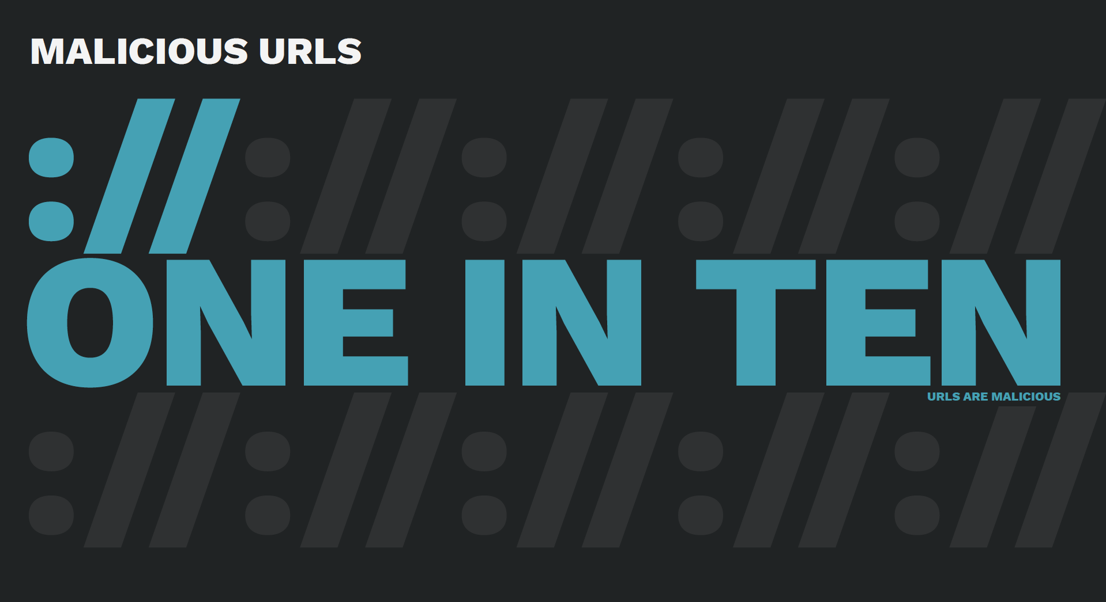
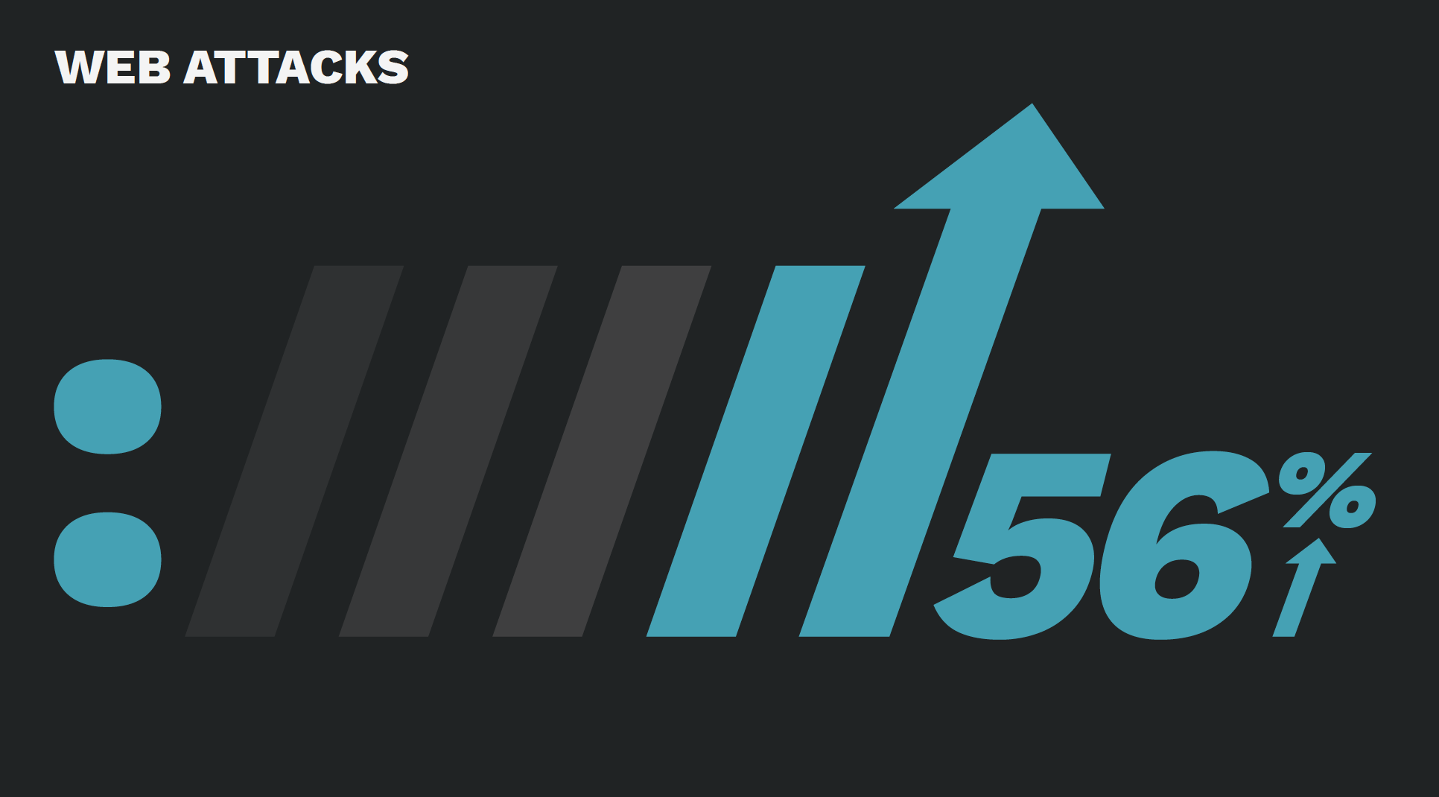
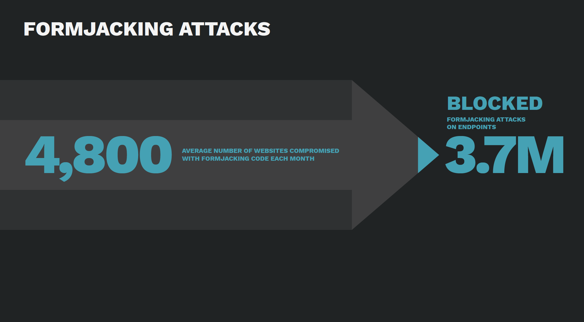
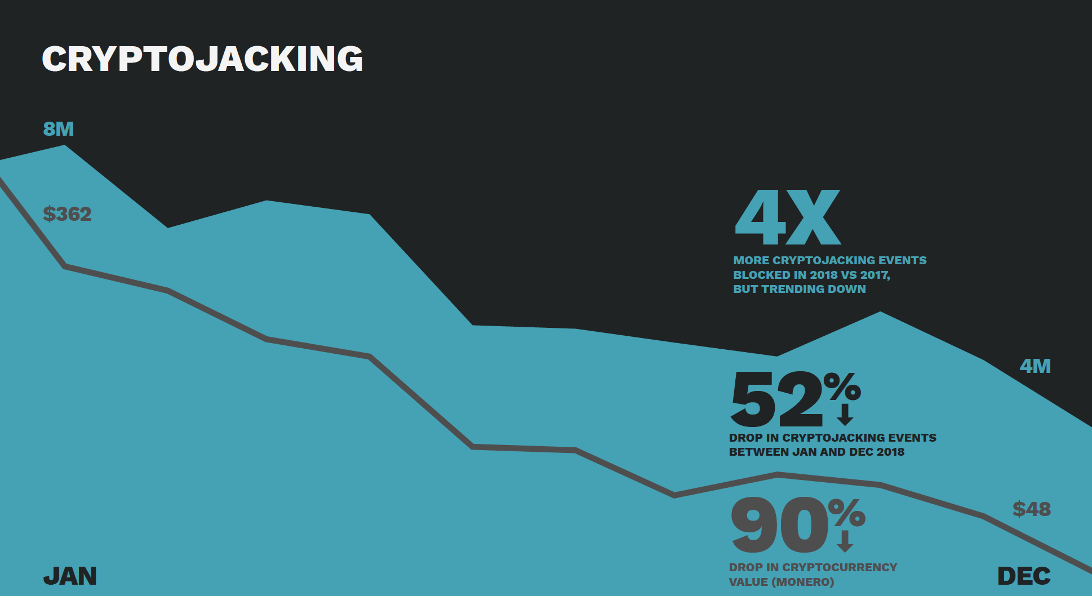
Security Trends (Symantec, Gartner, SANS, etc.)
Targeting end users, online underground economy, rapidly adaptable attacking techniques
2019 Symantec Internet Security Threat Report Volume 24:
Notes:
Added by Chuan Yue at the Colorado School of Mines.

Slide 17
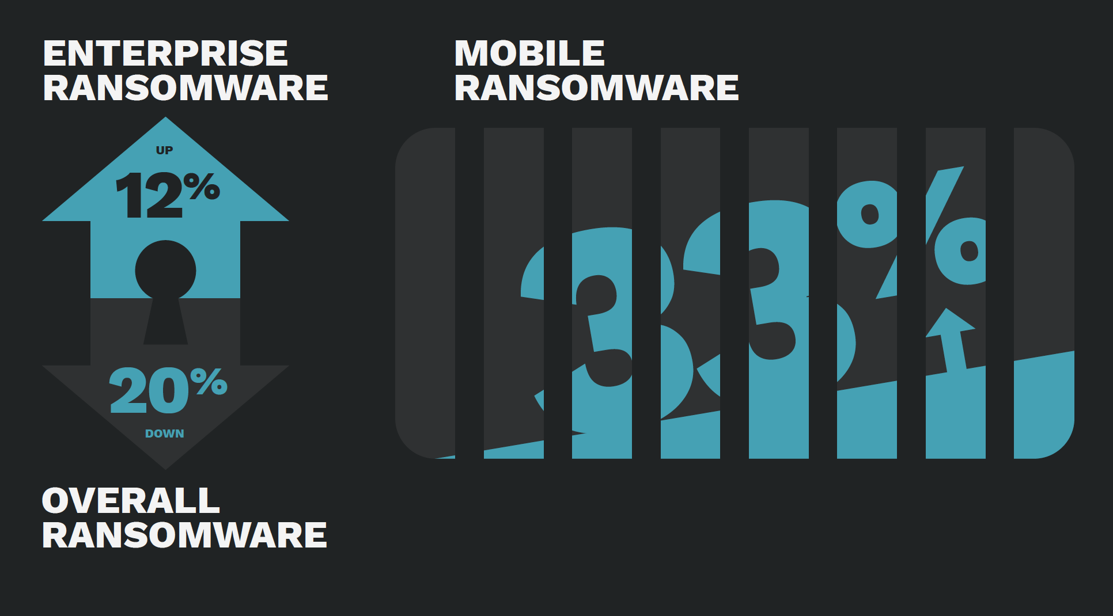
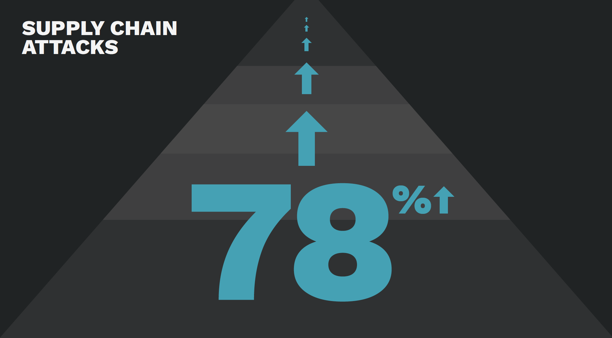
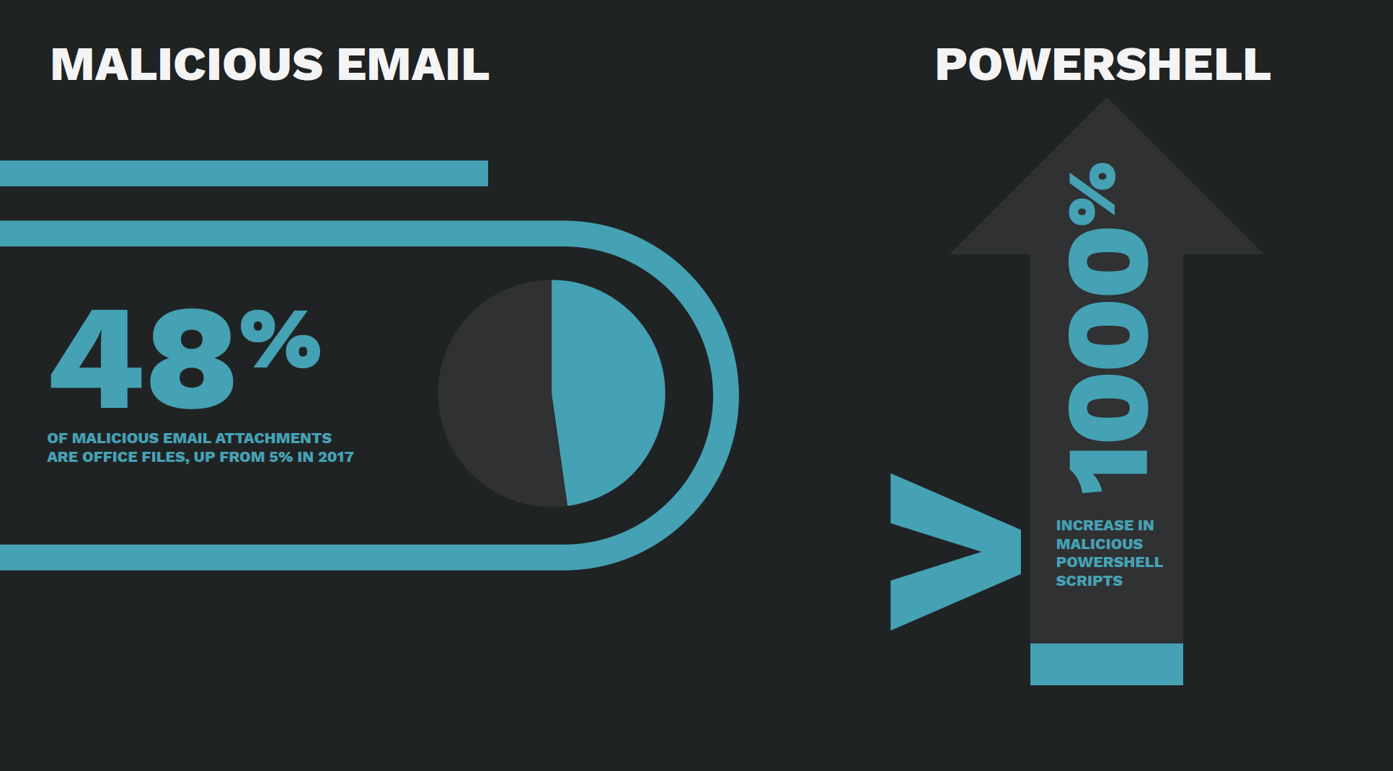
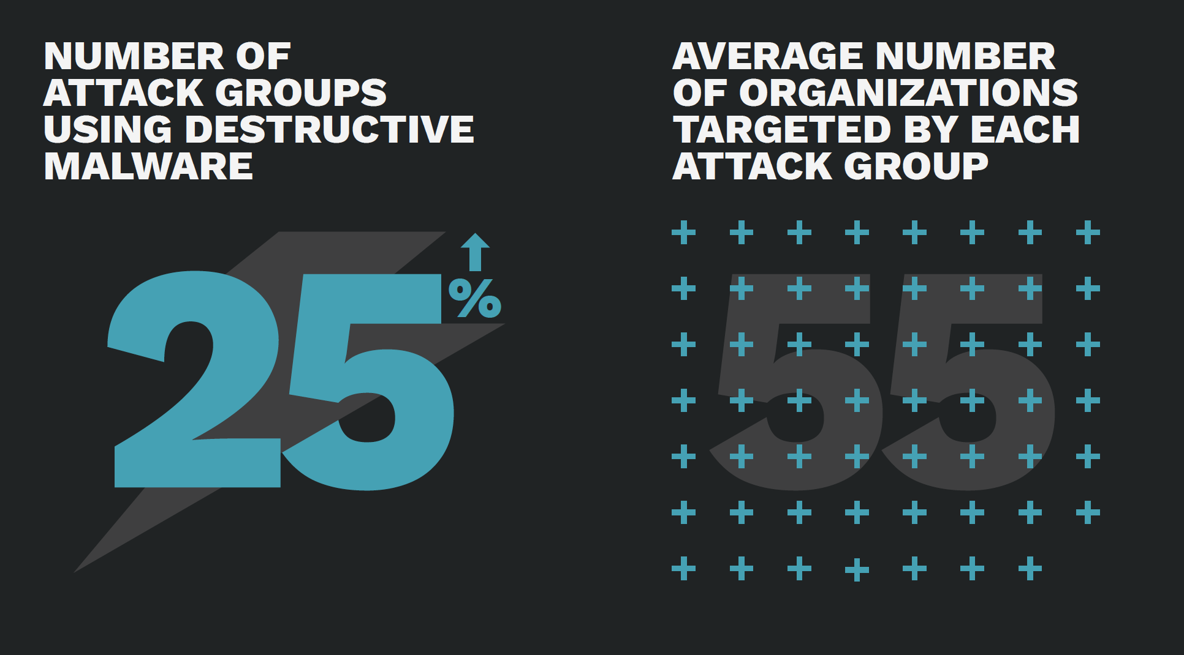
Security Trends Cont. (Symantec, Gartner, SANS, etc.)
Targeting end users, online underground economy, rapidly adaptable attacking techniques
2019 Symantec Internet Security Threat Report Volume 24:
Notes:
Added by Chuan Yue at the Colorado School of Mines.

Slide 18
Summary
terminology
functional requirements
security architecture
security strategy
security trends
Notes:
Week 1 1.2 Security Terminology and Architecture Summary.

